Slide 1

Predicting Future Sales demystifying the qualities that drive booze ‘R’ US’s liquor sales
Martin Hsu, Andrew Kerr, Erik Luu, Matteo Shafer, and Isabella McCarty
Notes:
Intro – Martin – 45sec
Project Scope – Matteo – 45sec
Model Fitting – Erik – 45sec
Key Findings – Martin – 30sec
Conclusion – Matteo – 15-30sec

Slide 2
INTRODUCTION
BOOZE ‘R’ US RFP
ANALYSIS OBJECTIVES
DATA COMMUNICATION
Notes:
Booze ‘R’ Us requested a model that can predict future sales for growth purposes
Analysis objectives: We propose a linear regression model as it is a simple yet powerful statistical model for understanding relationships. We want to produce a model that predicts future sales accurately
Data Communication: Using a business case study, we’ve produced a model that balances prediction and providing granular insights into what drives sales growth. The following is an example of what our modeling program.

Slide 3
PROJECT SCOPE -DATA COLLECTION-
IOWA LIQUOR SALES API
CASE STUDY: CASEY’S GENERAL STORE, 2017-2020
LIQUOR TYPE, SIZE, COST, TIME PERIOD
IDENTIFYING POSSIBLE SALES FACTORS
DATA AGGREGATION
STOREFRONT-MONTH LEVEL OBSERVATION
ESTIMATE SALES WITH STORE PURCHASES
Notes:
We got our data from API and singled out “Casey’s General Store” 2017-2020 as it matches Booze ‘R’ Us business model
We looked at variables: -Month, Year, Full Packs Sold, Single Bottles Sold, Bottle Size Category, Bottle Price Category, Alcohol Category
Feature Engineering: We will categorize liquors into small and large sizes. Similarly, we will categorize the sale price per bottle into three categories: cheap, average price, and expensive. Also, categorizing each alcohol into specific categories: Vodka, Tequila, and etc.
We aggregated the data so each observation is identified by a month, year, and store front

Slide 4
PROJECT SCOPE -MODEL FITTING-
​ MODEL RANKING​ ​ | ​ FEATURES IN MODEL​
1​ | MONTH, BOTTLE SIZE, BOTTLE COST, LIQUOR TYPE
2​ | YEAR, BOTTLES SIZE, BOTTLE COST, LIQUOR TYPE
3​ | BOTTLE SIZE, BOTTLE COST, LIQUOR TYPE
MODEL CHOICE: LINEAR REGRESSION MODEL WITH PENALIZATION TERM
VARIOUS COMBINATIONS OF FEATURES (PERIOD, SALE VOLUME, SIZE, COST, LIQUOR TYPE)
RIGOROUS VALIDATION PROCESS BY GENERATING AND TESTING MANY VERSIONS OF SAME MODELS
Notes:
Model Choice: Linear regression model with penalization term
Combinations of variables regarding period and volume of bottles sold by size, cost, and
To evaluate our models we used a rigorous validation process that generates multiple versions of the same model and averages their score.

Slide 5
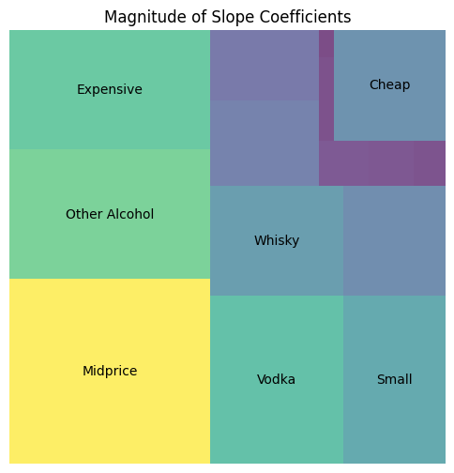
KEY FINDINGS
DETAIL-ORIENTED, INFO-DENSE APPROACH
SEASONALITY - MONTH
VALUE DRIVERS
MIDPRICE ($25-$50), EXPENSIVE (>$50)
SMALL BOTTLES (<750mL)
VODKA, WHISKEY, OTHER
GROWTH OBSTACLES
CHEAP LIQUOR (<$25)
Notes:
- Omitted sale volume (such as bottles sold
Sale Growth Drivers
- Number of expensive, mid price
- Number of small bottles sold
- Other alcohol bottles (Exotic not your typical), Vodka, Whiskey
Sale Growth Obstacles
- Cheap bottles sold
And based on that model results we will see if you guys should expand your operations or not

Slide 6
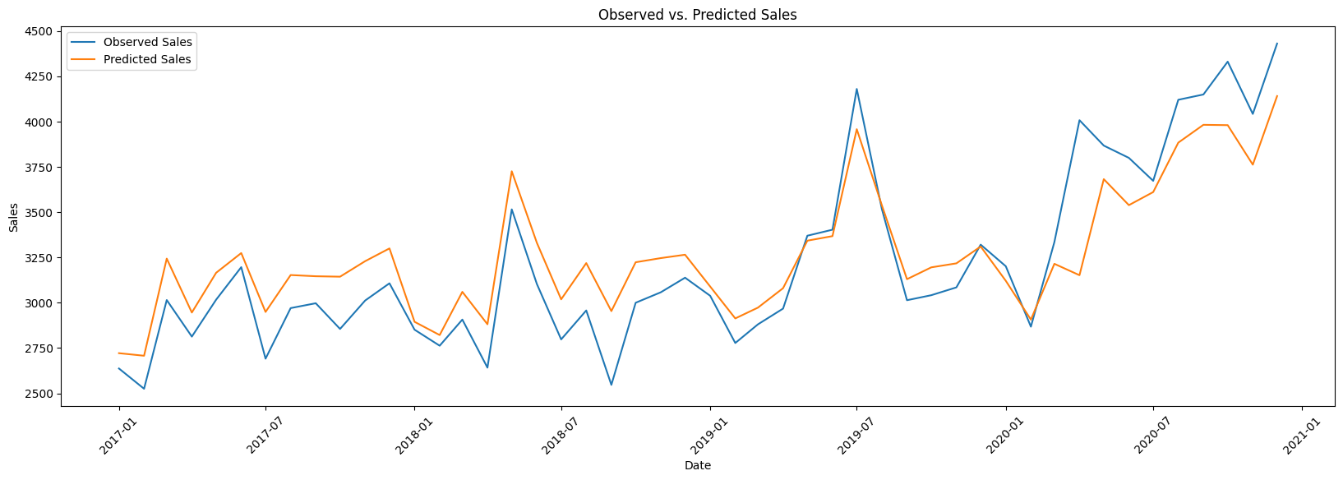
COMPARISON: CASEY’S GENERAL STORE 2017-2020,
AVERAGE MONTHLY SALES PER STOREFRONT (PREDICTED VS. OBSERVED)
FINAL MODEL
ROBUST SALES PREDICTIONS, VALUABLE GROWTH INSIGHTS
Notes:
We have developed a predictive model that has exceptional predictive power and provides valuable insights into the precise drivers of sales growth.
We created this for Casey’s and we can create this for Booze R Us

Slide 7
Unveiling Insights Analyzing Factors Influencing Alcohol Purchases in Iowa for DEAD
Martin Hsu, Andrew Kerr, Erik Luu, Matteo Shafer, and Isabella McCarty

Slide 8
INTRODUCTION
D.E.A.D MISSION
ANALYSIS OBJECTIVES
DATA COMMUNICATION
Notes:
BELLA – Drinking Excess Alcohol is Dangerous (DEAD) is interested in the driving factors behind small and large alcohol purchases in Iowa. We propose a machine learning model fitting a multiple linear regression model to a random sample of past sales data. The model will fit sales data and predict the quantity of alcohol sold. The features of the final model will represent the most influential factors driving alcohol purchasing behavior.

Slide 9
PROJECT SCOPE -DATA COLLECTION-
IOWA LIQUOR SALES API
RANDOM SAMPLING AND QUERIES
HOLIDAYS AND IOWA COLLEGES
INTRODUCTION OF POSSIBLE FACTORS
FEATURE ENGINEERING
ANALYTICAL METHODS AND CUSTOM FACTORS
Notes:
ANDREW
API:
- Random sample of 100k store purchases of alcohol from 2022-2023
Holiday & Colleges:
- Collected past days of government-observed holidays as well as colleges in each city along with student enrollment
Engineered Features:
- Categorization of general liquor types (e.g. Vodaka, Brandy, Rum)
- Whether the store purchase was within 2 weeks prior to government-observed holidays
- Count of colleges in city where store is located
- Categorization of size of student population in city: Small, Med, Large

Slide 10
PROJECT SCOPE -MODEL FITTING-
MODEL RANKING | FEATURES IN MODEL
1 | LIQUOR CATEGORY, HOLIDAY, COST PER LITER, COLLEGE COUNT
2 | LIQUOR CATEGORY, HOLIDAY, COST PER LITER, STUDENT POPULATION
3 | LIQUOR CATEGORY, HOLIDAY, COST PER LITER, STUDENT POPULATION, DAY OF THE WEEK
4 | LIQUOR CATEGORY, HOLIDAY, COLLEGE COUNT, DAY OF THE WEEK, MONTH, COUNTY, SIZE OF STUDENT POPULATION
5 | LIQUOR CATEGORY, HOLIDAY, COLLEGE COUNT, DAY OF THE WEEK, MONTH, SIZE OF STUDENT POPULATION
MODEL CHOICE: LINEAR REGRESSION MODEL WITH PENALIZATION TERM
VARIOUS COMBINATIONS OF FEATURES TESTED IN THIS MODEL
VALIDATION METRIC TO MAKE INTER-MODEL COMPARISONS
Notes:
BELLA

Slide 11
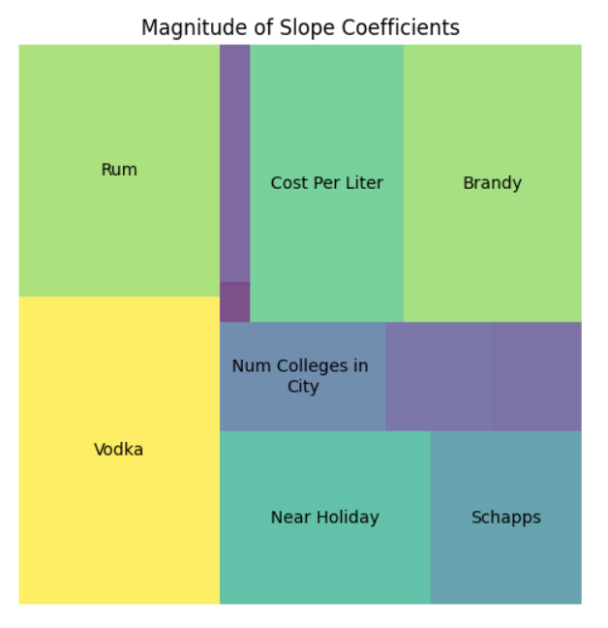
KEY FINDINGS
FEATURES THAT LEAD TO LARGER ALCOHOL PURCHASES
VODKA, RUM, HOLIDAY
FEATURES THAT LEAD TO SMALLER ALCOHOL PURCHASES
BRANDY, COST PER LITER
NOTABLE FEATURES
SCHNAPPS, COLLEGE COUNT
Notes:
ANDREW
Graph:
- Size of rectangles indicates the power of the factor – how much this factor influences the amount of liters bought by the store (ignoring whether they caused an increase or decrease)
Interpretations:
- When buying liquor, stores tend to buy larger quantities of vodka and rum and lower quantities of brandy
- Stores tend to buy more alcohol around holidays
- Stores tend to buy less expensive alcohol --> stores sell more cheap than expensive alcohol

Slide 12
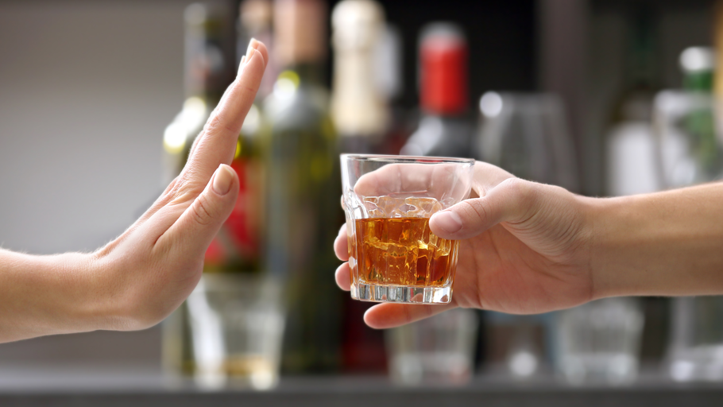
RECOMMENDATIONS
ACTIONABLE RECOMMENDATIONS TO PROMOTE SAFER ALCHOL CULTURE IN IOWA
This Photo by Unknown Author is licensed under CC BY-NC-ND
Notes:
BELLA

